Slide 1
Ranking Related Entities Components and Analyses
CIKM’10
Advisor: Jia Ling, Koh
Speaker: Yu Cheng, Hsieh

Slide 2
Outline
Introduction
Approach
Experiment
Discussion
Conclusion

Slide 3
Introduction
Related Entity Finding(REF) task: Given,
1.Source entity
2. Relation
3. Target Entity type
Discover entities that satisfied the relation
and the target type, and return their
homepage.
“Miks”
“Members of KDD lab”
People
“Arion” → homepage of Arion “Handsome Shih” → homepage of “Handsome Shih”

Slide 4
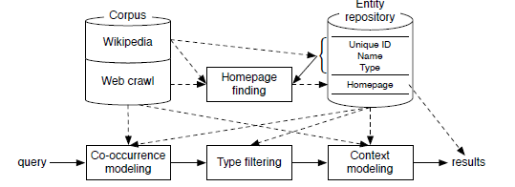
Introduction
Component of an idealized entity finding system
Focuses on Recall
Precision improvement

Slide 5
Introduction
Main goal:
Addresses the issue of balancing
precision and recall.

Slide 6
Approach
E: source entity, T: Target type, R: Relation
Co-occurrence
modeling
Type filtering
Context
modeling
query
results

Slide 7
Outline
Introduction
Approach
Experiment
Discussion
Conclusion
- Experiment Setup
- Co-occurrence Modeling
- Type Filtering
- Context Modeling
- Improved Estimations
- Homepage Finding

Slide 8
Experiment Setup
Research questions
Co-occurrence
modeling
Type filtering
Context
modeling
query
results
Can this framework effectively incorporate additional heuristics in order to be competitive with other state-of-art approaches ?
Can a larger corpus improve the accuracy of estimation of these two models ?
How do different measures for computing co-occurrence affect the recall of pure Co-occurrence model
Can it improve the precision without hurting recall ?
Can
recall and precision be enhanced?
2. ensure the source and target
entities engage in the right relation?

Slide 9
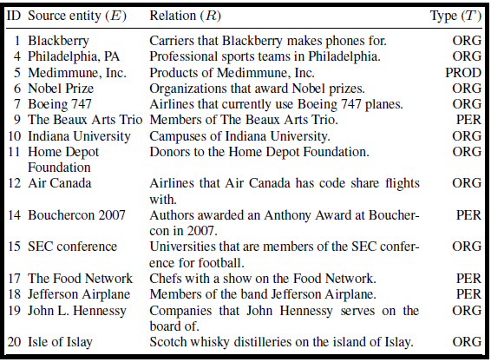
Experiment Setup
Entity recognition and normalization
- Anchor texts was considered to recognize the named
entity
- Named Entity Normalization:
e.g. {“Schumacher”, “Schumi”, “M. Schumacher”} → “Michael Schumacher”
Test topics

Slide 10
Experiment
- Experiment Setup
- Co-occurrence Modeling
- Type Filtering
- Context Modeling
- Improved Estimations
- Homepage Finding

Slide 11
Co-Occurrence Modeling
MLE:
Hypothesis test:
PMI:
Log likelihood ratio:
Co-occurrence
modeling
query
results

Slide 12
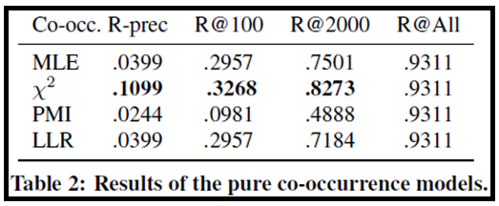
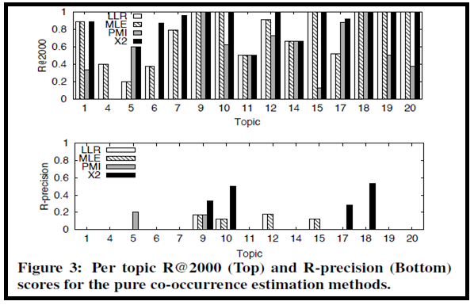
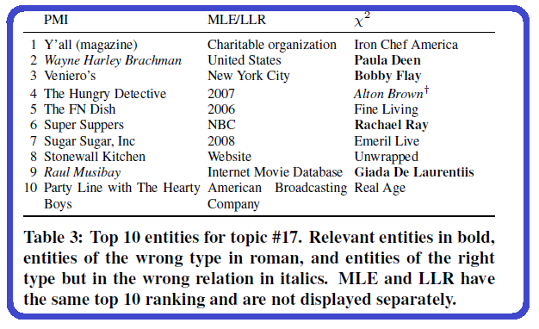
Co-Occurrence Modeling
# of relevant entities for a topic
Relation with the target entity: “Chefs with a show on the Food Network”

Slide 13
Co-Occurrence Modeling – Summary
MLE and LLR favor popular entities
PMI favors rare entities
$x^{2}$ Hypothesis test favors entities that co-occur frequently
All methods and topics suffer from entities of the wrong type polluting the rankings

Slide 14
Experiment
- Experiment Setup
- Co-occurrence Modeling
- Type Filtering
- Context Modeling
- Improved Estimations
- Homepage Finding

Slide 15
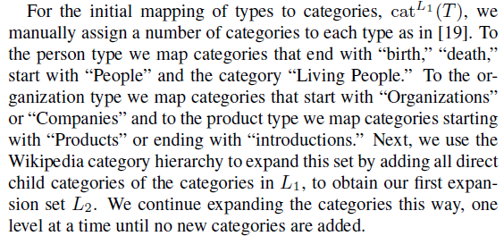
Type Filtering
$cat(T)$ : Map each of the entity types to a set of Wikipedia categories ( )
$cat(e)$ :Map entities to categories
Co-occurrence
modeling
Type filtering
query
results
$$L_{n}:chosen level of expansion$$

Slide 16
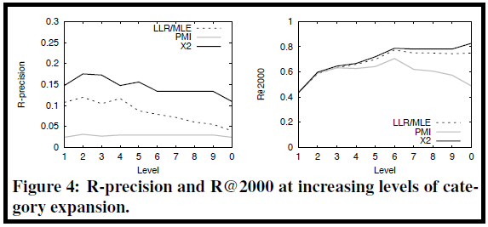
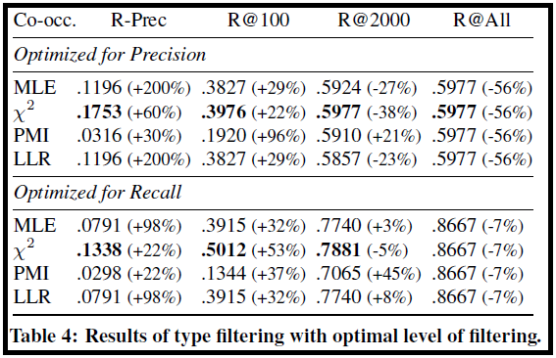
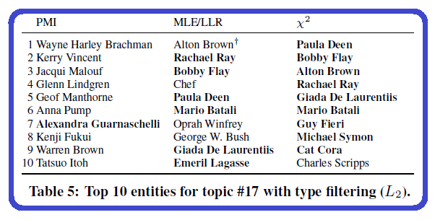
Type Filtering
Relation with the target entity: “Chefs with a show on the Food Network”
( Optimized at level 2 )
( Optimized at level 6 )

Slide 17
Type Filtering - Summary
By varying the level of expansion we can effectively aim either for R-precision or for R@2000, without hurting the other.
Optimizing category expansion levels carry the risk of overfitting.
The error of entities of the right type but not engaged in the right relation is more prominent

Slide 18
Experiment
- Experiment Setup
- Co-occurrence Modeling
- Type Filtering
- Context Modeling
- Improved Estimations
- Homepage Finding

Slide 19
Context Model
Co-occurrence
modeling
Type filtering
Context
modeling
query
results

Slide 20
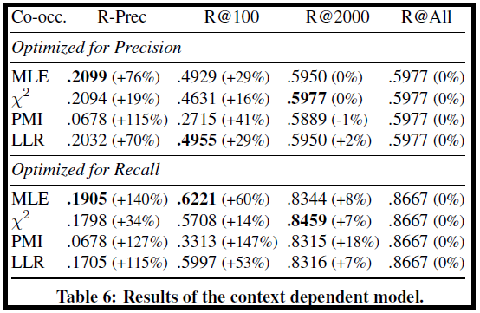
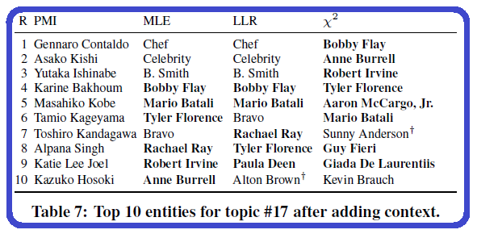
Context Model
Relation with the target entity: “Chefs with a show on the Food Network”

Slide 21
Context Model - Summary
It’s hard to discover entities which occur in very few documents (<10)
MLE and LLR favor this model
$x^{2}$ model show a large overlap large overlap with those identified on the basis of context

Slide 22
Summary of Using Wikipedia as Corpus
Pure co-occurrence models are unreliable
The corpus is too small for constructing accurate context models

Slide 23
Experiment
- Experiment Setup
- Co-occurrence Modeling
- Type Filtering
- Context Modeling
- Improved Estimations
- Homepage Finding

Slide 24
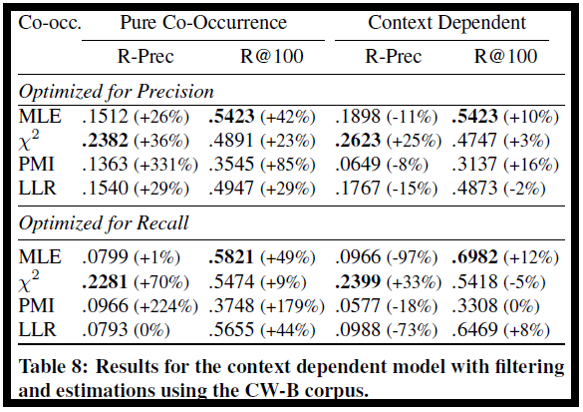
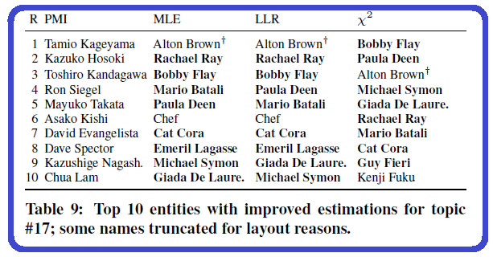
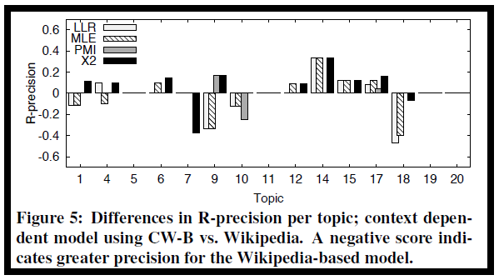
Improved Estimations
CW-B (Larger corpus)
CW-B based model improves R-precision scores on a numbers of topics
Co-occurrence
modeling
Type filtering
Context
modeling
query
results
$x^{2}$ method reached good balance between precision and recall.
Working entity set:
Entities returned for PMI without filtering as this produced the highest R@2000 ( 87% )

Slide 25
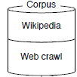
Homepage Finding
Address homepage finding as a document retrieval problem
Use the entity term as a query $, P\left( q=e_{n} \right| d)$
Using a combination of multiple document fields to represent documents
Using information on Wikipedia pages of source entity, (e.g. external link ), to discover homepage of candidate entities

Slide 26
Homepage Finding
Ranking list
: proportional to the position of the other external
link on the Wikipedia page
: the possible homepage of e
: the external link of e on Wikipedia page
- =
1, if there is a homepage URL of e in DBpedia
0, otherwise.
- Set equal weight for these two components

Slide 27
Outline
Introduction
Approach
Experiment
Discussion
Conclusion

Slide 28
Discussion
Improved type filtering
Anchor-based co-occurrence
Adjusted judgements
Wikipedia-based evaluation

Slide 29
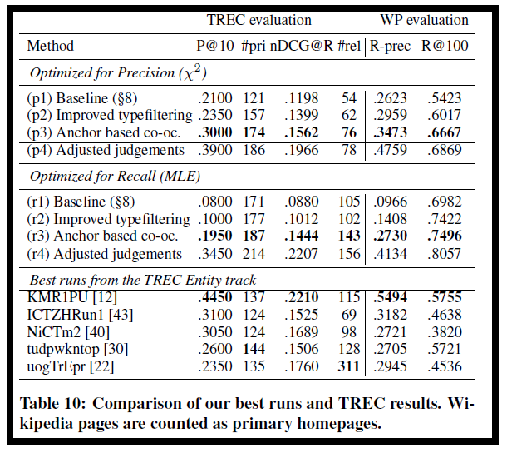
Discussion
Improved type filtering
Serdyukov and de Vries use DBpedia ontology to perform type
filtering
Follow the approach and map the ontology categories “Person” and “Organization” to target type “PER and ORG” respectively
1. Positive effect on both precision and recall
2. Filtering based on the DBpedia is precise, but only
cover some of the entities in Wikipedia

Slide 30
Discussion
Anchor-based co-occurrence
[30] [40] only consider entities that link to, or are linked from the
Wikipedia page of the input entity
: number of times the candidate e occurs in the anchor text
on the Wikipedia page of the input entity
: the other way.
Work well for most topics the relevant entities occur as anchor texts on the page

Slide 31
Conclusion
An architecture was examined for addressing the related entity finding.
Four measures to identify entity co-occurrence
Category expansion can be tuned towards precision and recall
Context model improve both precision and recall
Using larger corpus improve the estimation of both co-occurrence model and context model
This model can effectively incorporate additional heuristic

